Slide 1
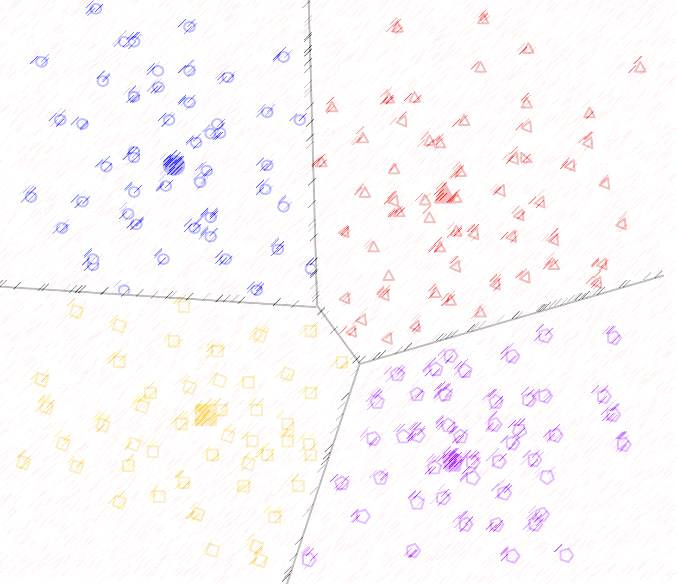

Lecture 6: Clustering Algorithms (Part II)
CSE445 Machine Learning
Dr. Jilan Samiuddin (JSA)
Assistant Professor
North South University

Slide 2
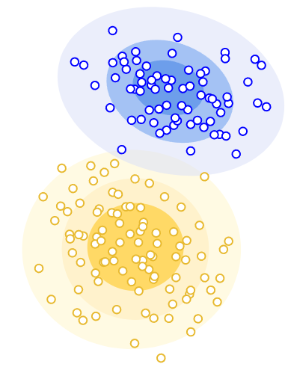
Gaussian Mixture Model (GMM)
Image credit: Google

Slide 3
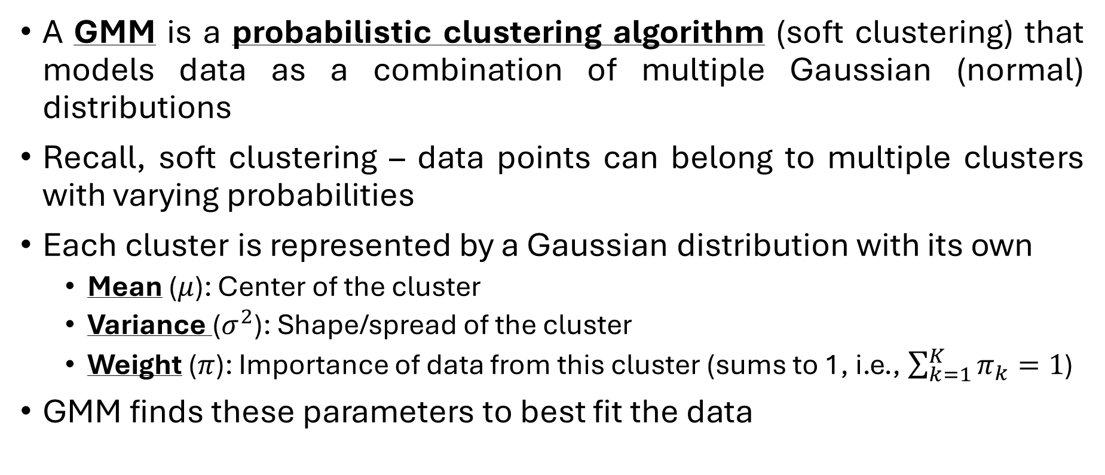
Introduction
A GMM is a probabilistic clustering algorithm (soft clustering) that models data as a combination of multiple Gaussian (normal) distributions
Recall, soft clustering – data points can belong to multiple clusters with varying probabilities
Each cluster is represented by a Gaussian distribution with its own
Mean ($μ$): Center of the cluster
Variance ($σ^{2}$): Shape/spread of the cluster
Weight ($π$): Importance of data from this cluster (sums to 1, i.e., $\sum_{k=1}^{K}{π_{k}}=1$)
GMM finds these parameters to best fit the data

Slide 4
Expectation-Maximization (EM) Algorithm
EM algorithm, which is an iterative method, is used to optimize the parameters of the Gaussian distributions so that GMM fits to the data
EM iterates between two key phases:
Expectation Step (E-Step)
Computes probabilistic cluster assignments
For every data point, calculates: The likelihood (probability) it belongs to each cluster
Maximization Step (M-Step)
Refines the model parameters
Updates the estimates for:
Means: Adjusts cluster centers toward high-probability points
Covariances/Variances: Reshapes clusters based on member distributions
Weights: Rebalances cluster importance
Uses the probabilities from the E-step as weighting factors

Slide 5
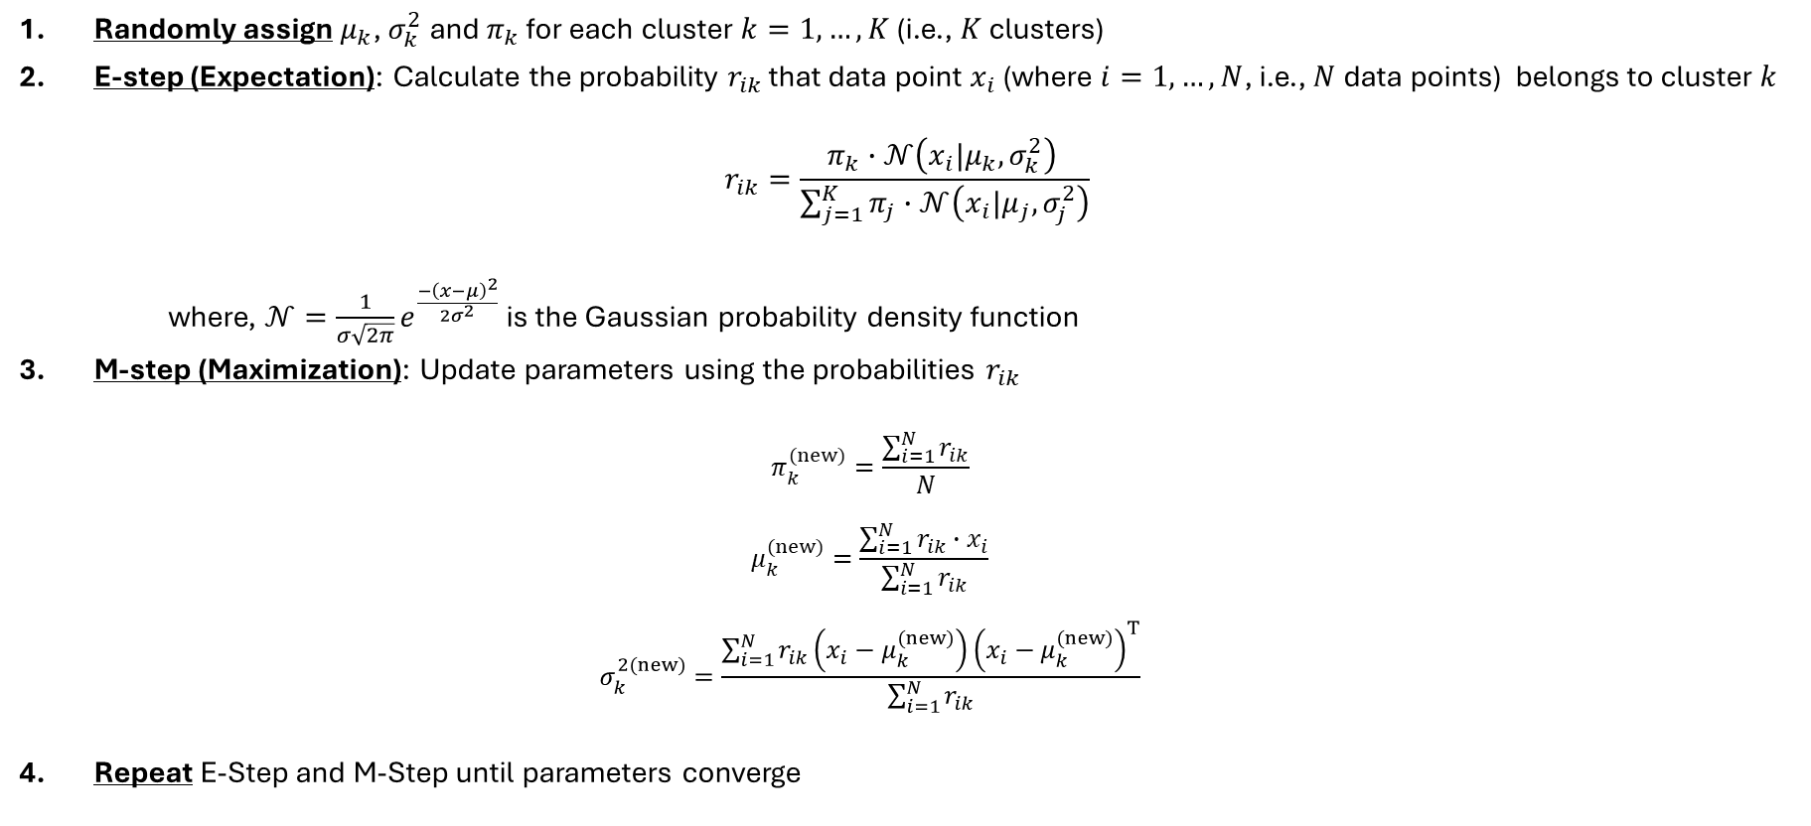
EM Algorithm: Steps (1-D Data)
Randomly assign $μ_{k}$, $σ_{k}^{2}$ and $π_{k}$ for each cluster $k=1,…,K$ (i.e., $K$ clusters)
E-step (Expectation): Calculate the probability $r_{ik}$ that data point $x_{i}$(where $i=1,…,N$, i.e., $N$ data points) belongs to cluster $k$
$$r_{ik}=\frac{π_{k}∙𝒩\left(x_{i}|μ_{k},σ_{k}^{2}\right) }{\sum_{j=1}^{K}{π_{j}∙𝒩\left(x_{i}|μ_{j},σ_{j}^{2}\right)}}$$
where, $𝒩=\frac{1}{σ\sqrt{2π}}e^{\frac{−{\left(x−μ\right)}^{2}}{2σ^{2}}}$ is the Gaussian probability density function
M-step (Maximization): Update parameters using the probabilities $r_{ik}$
$$π_{k}^{(new)}=\frac{\sum_{i=1}^{N}{r_{ik}}}{N}$$
$$μ_{k}^{(new)}=\frac{\sum_{i=1}^{N}{r_{ik}}∙x_{i}}{\sum_{i=1}^{N}{r_{ik}}}$$
$$σ_{k}^{2(new)}=\frac{\sum_{i=1}^{N}{r_{ik}}\left(x_{i}−μ_{k}^{(new)}\right){\left(x_{i}−μ_{k}^{(new)}\right)}^{T}}{\sum_{i=1}^{N}{r_{ik}}}$$
Repeat E-Step and M-Step until parameters converge

Slide 6


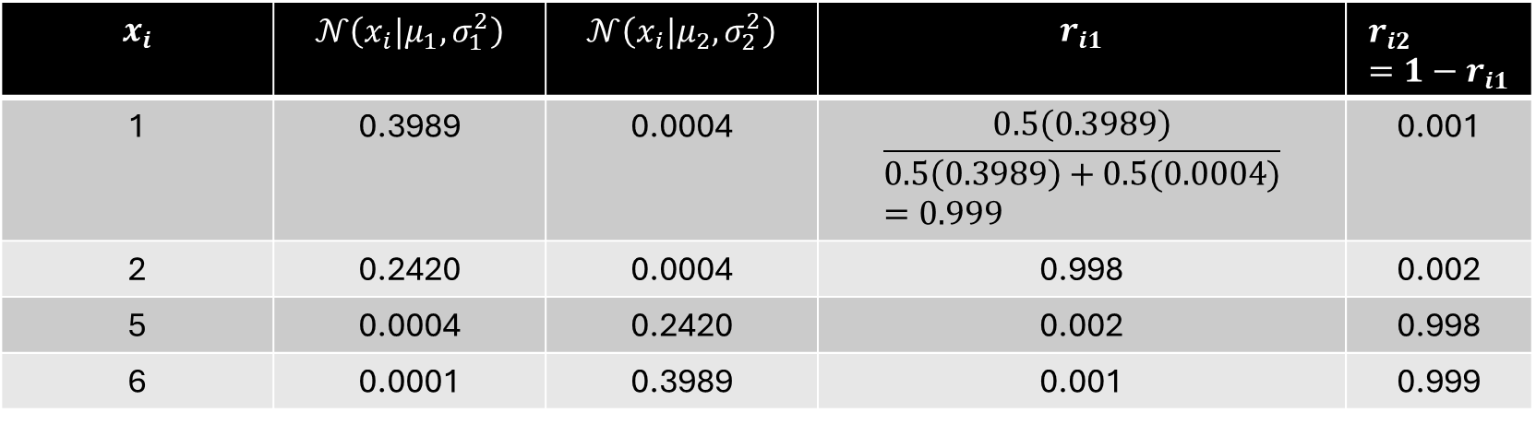
EM Algorithm: Example
Data: $X=\left[1,2,5,6\right], K=2$
Initialize parameters:
Cluster 1: $μ_{1}=1$, $σ_{1}^{2}=1$ and $π_{1}=0.5$
Cluster 2: $μ_{2}=6$, $σ_{2}^{2}=1$ and $π_{2}=0.5$
Iteration 1:Step 1: E-step
$$r_{ik}=\frac{π_{k}∙𝒩\left(x_{i}|μ_{k},σ_{k}^{2}\right) }{\sum_{j=1}^{K}{π_{j}∙𝒩\left(x_{i}|μ_{j},σ_{j}^{2}\right)}}$$
$$x_{i}$$ | $$𝒩\left(x_{i}|μ_{1},σ_{1}^{2}\right)$$ | $$𝒩\left(x_{i}|μ_{2},σ_{2}^{2}\right)$$ | $$r_{i1}$$ | $$r_{i2}=1−r_{i1}$$
1 | 0.3989 | 0.0004 | $$\frac{0.5\left(0.3989\right)}{0.5\left(0.3989\right)+0.5(0.0004)}=0.999$$ | 0.001
2 | 0.2420 | 0.0004 | 0.998 | 0.002
5 | 0.0004 | 0.2420 | 0.002 | 0.998
6 | 0.0001 | 0.3989 | 0.001 | 0.999

Slide 7
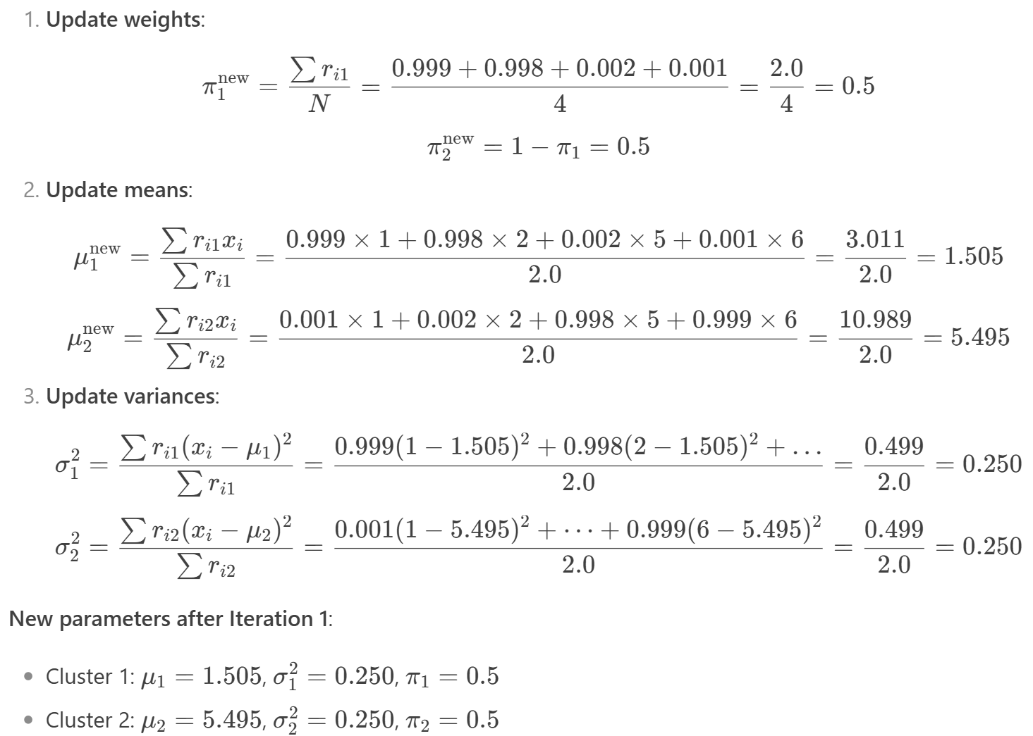
EM Algorithm: Example (contd.)
Iteration 1:
Step 2: M-step

Slide 8

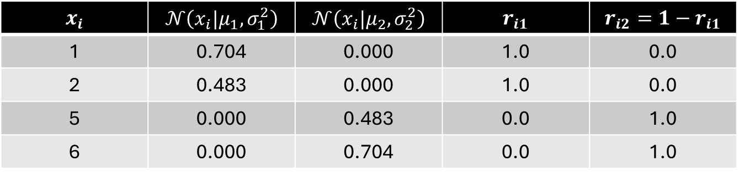
EM Algorithm: Example
New parameters
Cluster 1: $μ_{1}=1$.505, $σ_{1}^{2}=0.250$ and $π_{1}=0.5$
Cluster 2: $μ_{2}=5.495$, $σ_{2}^{2}=0.250$ and $π_{2}=0.5$
Iteration 2:
Step 1: E-step
$$x_{i}$$ | $$𝒩\left(x_{i}|μ_{1},σ_{1}^{2}\right)$$ | $$𝒩\left(x_{i}|μ_{2},σ_{2}^{2}\right)$$ | $$r_{i1}$$ | $$r_{i2}=1−r_{i1}$$
1 | 0.704 | 0.000 | 1.0 | 0.0
2 | 0.483 | 0.000 | 1.0 | 0.0
5 | 0.000 | 0.483 | 0.0 | 1.0
6 | 0.000 | 0.704 | 0.0 | 1.0

Slide 9
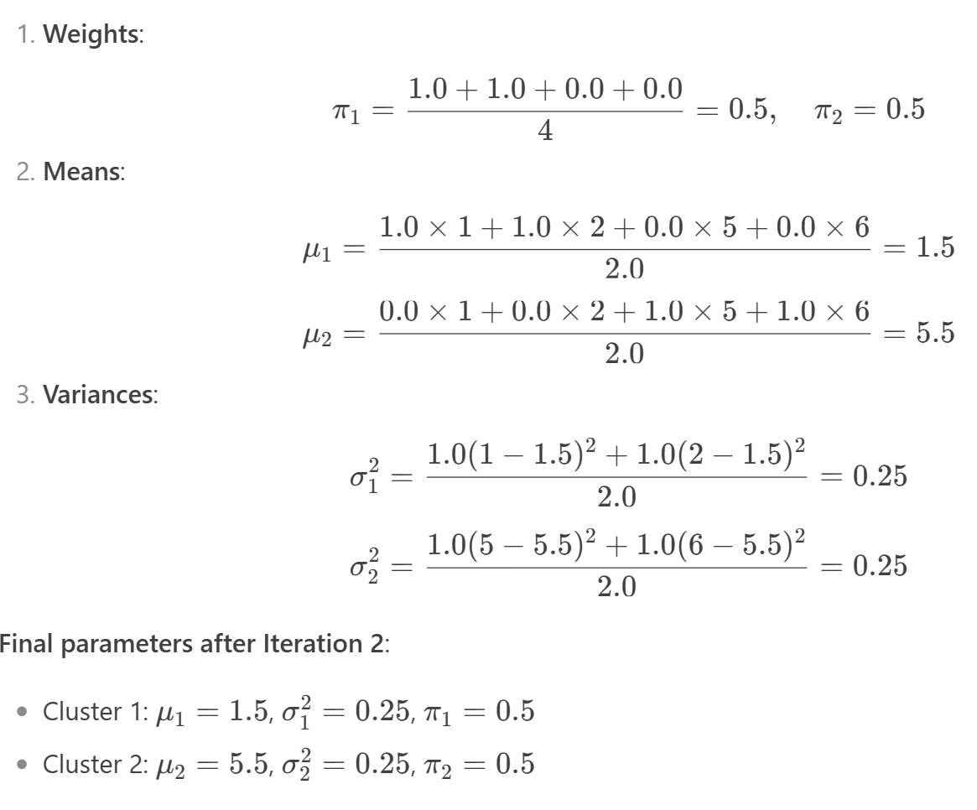
EM Algorithm: Example (contd.)
Iteration 2:
Step 2: M-step

Slide 10
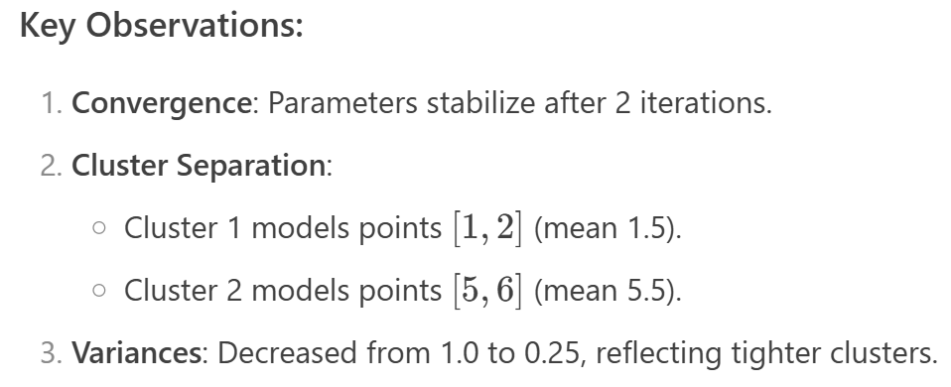
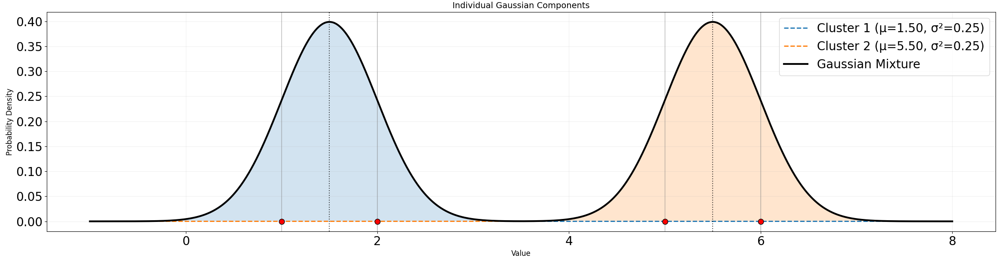
EM Algorithm: Example (contd.)
1
5

Slide 11

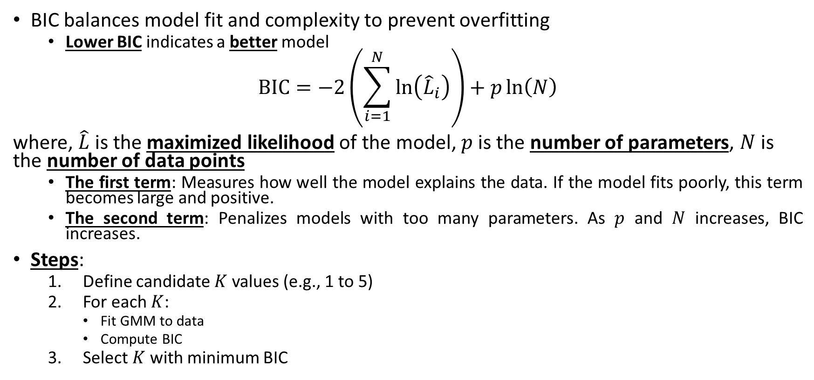
Bayesian Information Criterion (BIC) for Optimal $K$
BIC balances model fit and complexity to prevent overfitting
Lower BIC indicates a better model
$$BIC=−2\left(\sum_{i=1}^{N}{\ln\left({\hat{L}}_{i}\right)}\right)+p\ln\left(N\right)$$
where, $\hat{L}$is the maximized likelihood of the model, $p$ is the number of parameters, $N$ is the number of data points
The first term: Measures how well the model explains the data. If the model fits poorly, this term becomes large and positive.
The second term: Penalizes models with too many parameters. As $p$ and $N$ increases, BIC increases.
Steps:
Define candidate $K$ values (e.g., 1 to 5)
For each $K$:
Fit GMM to data
Compute BIC
Select $K$ with minimum BIC

Slide 12

BIC Parameters
BIC equation:
$$BIC=−2\left(\sum_{i=1}^{N}{\ln\left({\hat{L}}_{i}\right)}\right)+p\ln\left(N\right)$$
where,
$${\hat{L}}_{i}=\sum_{k=1}^{K}{π_{k}∙𝒩\left(x_{i}|μ_{k},σ_{k}^{2}\right)}$$
$p=\left(K−1\right)+K+K$ ← for 1D data

Slide 13

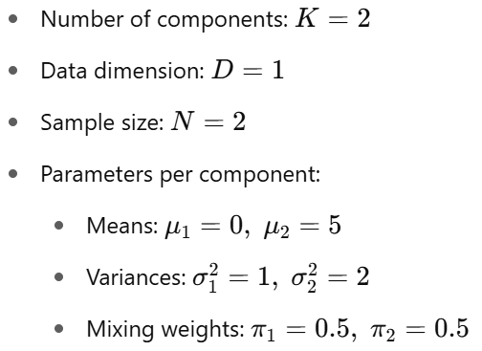
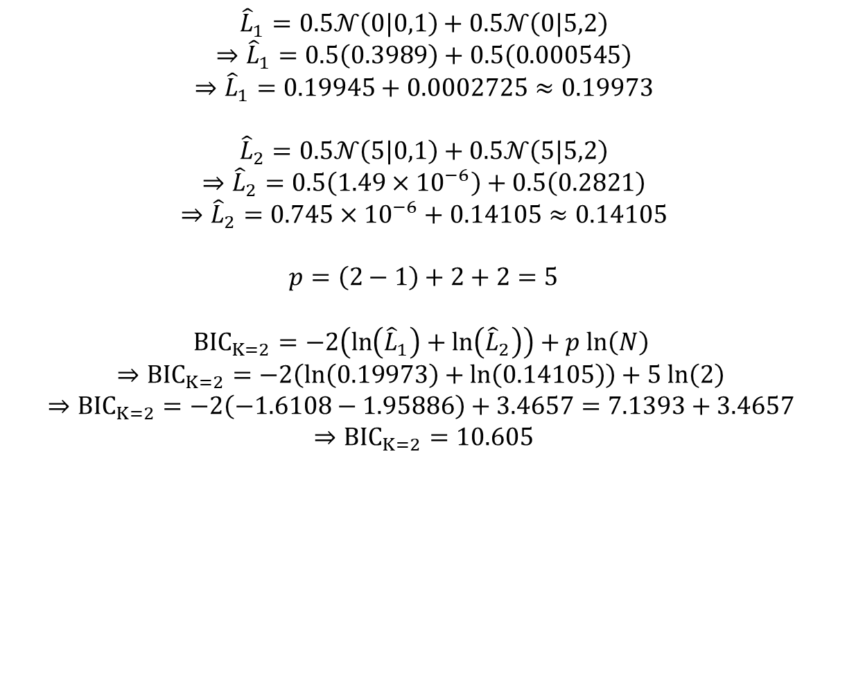
BIC Example (N=2)
$${\hat{L}}_{1}=0.5𝒩\left(0|0,1\right)+0.5𝒩\left(0|5,2\right)$$
$$⇒{\hat{L}}_{1}=0.5\left(0.3989\right)+0.5\left(0.000545\right)$$
$$⇒{\hat{L}}_{1}=0.19945+0.0002725≈0.19973$$
$${\hat{L}}_{2}=0.5𝒩\left(5|0,1\right)+0.5𝒩\left(5|5,2\right)$$
$$⇒{\hat{L}}_{2}=0.5\left(1.49×{10}^{−6}\right)+0.5\left(0.2821\right)$$
$$⇒{\hat{L}}_{2}=0.745×{10}^{−6}+0.14105≈0.14105$$
$$p=\left(2−1\right)+2+2=5$$
$${BIC}_{K=2}=−2\left(\ln\left({\hat{L}}_{1}\right)+\ln\left({\hat{L}}_{2}\right)\right)+p ln\left(N\right)$$
$$⇒{BIC}_{K=2}=−2\left(\ln\left(0.19973\right)+\ln\left(0.14105\right)\right)+5 ln\left(2\right)$$
$$⇒{BIC}_{K=2}=−2\left(−1.6108−1.95886\right)+3.4657=7.1393+3.4657$$
$$⇒{BIC}_{K=2}=10.605$$
Similarly, BIC can be calculated for different values of K and the one with the lowest BIC value is chosen.

Slide 14
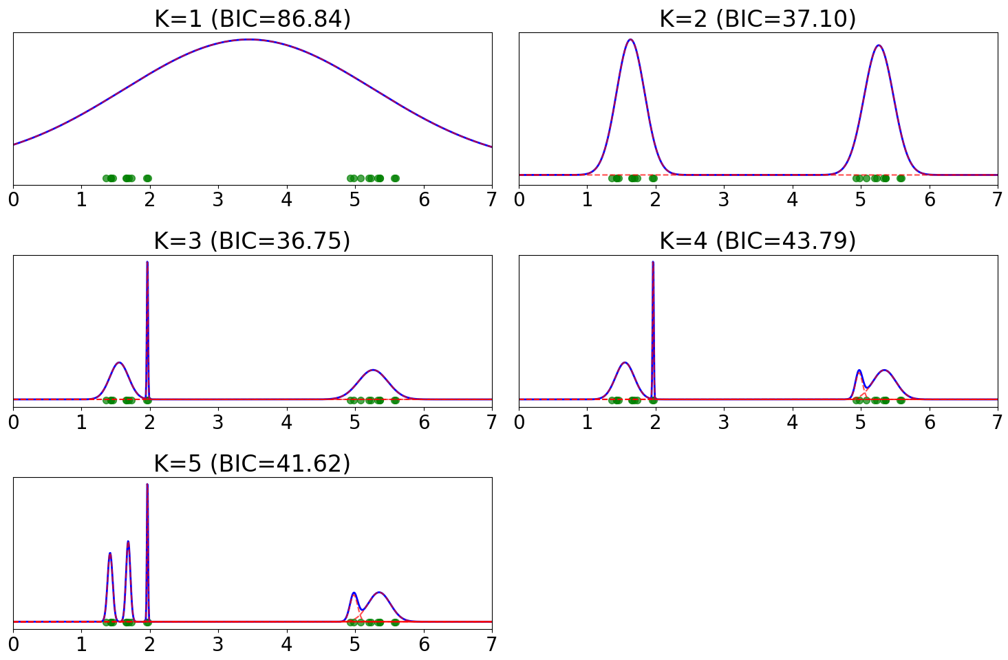
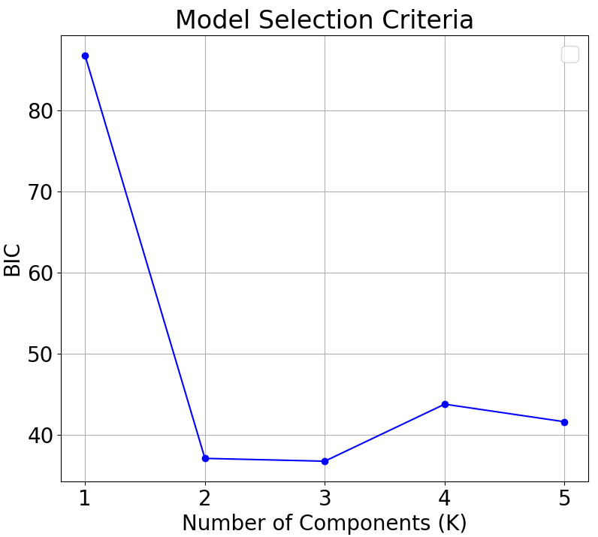
BIC Example 2 (N=20)
Underfitting
Overfitting

Slide 15
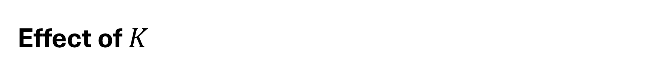
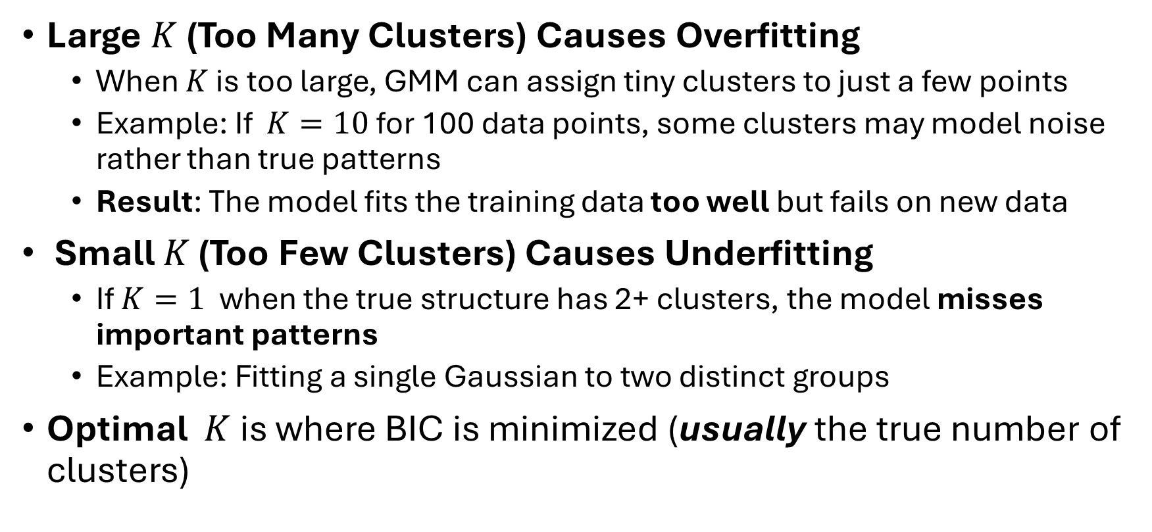
Effect of $K$
Large $K$(Too Many Clusters) Causes Overfitting
When $K$ is too large, GMM can assign tiny clusters to just a few points
Example: If $K=10$ for 100 data points, some clusters may model noise rather than true patterns
Result: The model fits the training data too well but fails on new data
Small $K$ (Too Few Clusters) Causes Underfitting
If $K=1$ when the true structure has 2+ clusters, the model misses important patterns
Example: Fitting a single Gaussian to two distinct groups
Optimal $K$is where BIC is minimized (usually the true number of clusters)

